Slide 1
RCCC CCP

Slide 2
RCCC Homepage

Slide 3
RCCC Programs and Courses Page

Slide 4
RCCC CCP Counselor Page https://www.rccc.edu/highschool/ccp-for-hs-counselors/

Slide 5
CCP Student Agreement Form
Enter “First” Then “Last” Name
Enter Email x 2
Enter Date of Birth
Use drop down and type in “Jesse”
Enter Parent Info and Relationship
Enter Parent Email x 2
Agree to 5 Bullets
RCCC, Parents, and Carson can talk
Fees, Follow RSS and CCP Rules
Sign (Gonna be UGLY) and Submit

Slide 6
CCP Application & CFNC Log in Page

Slide 7
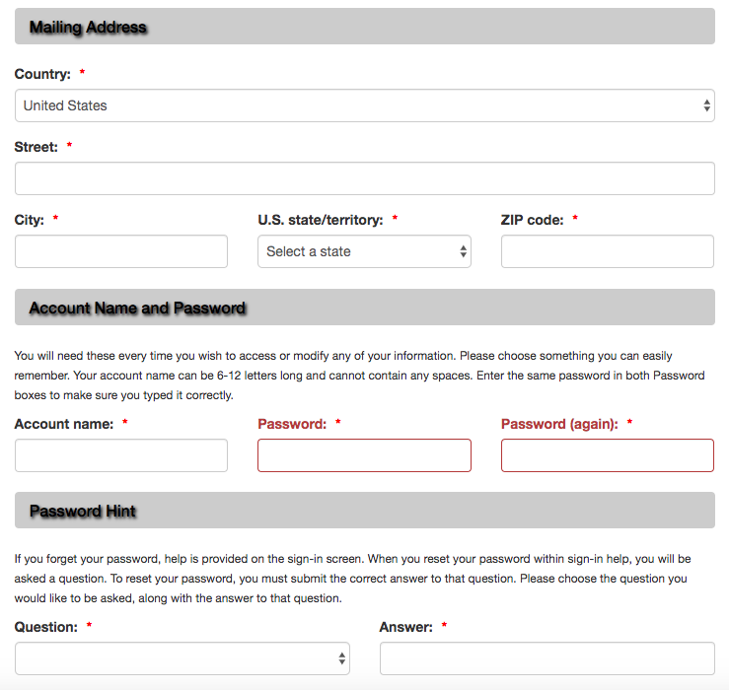
Create an Account

Slide 8
Name and Address Page
Former Name – Yes or No
Phone Number – Requires the “–”
Copy and Paste Email
Should see a check mark on left

Slide 9
Personal Page
NC ID – School lunch #
Gender – Male or Female
Role – High School Student
CCP Residency - Check Yes
Should see a check mark on left

Slide 10
Enrollment Information Selection of Pathway is VERY important!
Enrollment Term – Fall 2020
First time CCP – Yes
College Transfer Pathway
*Associate of Arts (Unless planning on taking Calulus, Bio II, Chem. II or Physics II)
*College Technical Education
Welding / Cosmo / ETC.

Slide 11
Enrollment Information
Goals - Transfer or Gain Skills
Employment Status - Pick one
Learn about college – Pick one
Are you suspended – Yes or no
Should see a check mark on left

Slide 12
Educational Information
School – Type “Jesse”
Use the drop down
Type – Choose “Public”
County – Rowan
Graduation Date
Highest Grade finished – 10 or 11
GED – Neither
Should see a check mark on left

Slide 13
Student Statement
Type in your Full Name
Type in Parent Name
Click on Submit

Slide 14
Submit Page
Click that you want your transcript sent
Click on Submit

Slide 15
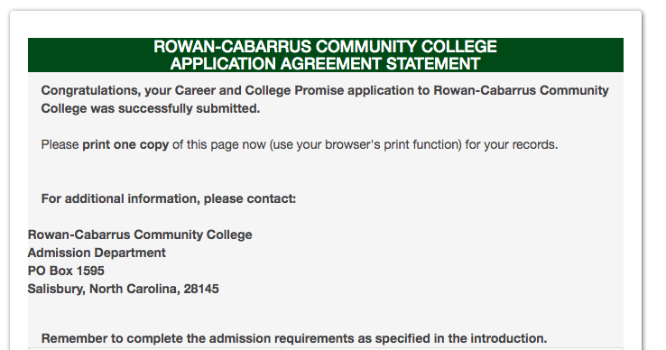
Application Agreement Statement

