Slide 1
All About the College Application Process
Caption

Slide 2
Overview
Colleges & Universities (Public/Private)
Testing
Admissions
Financial Aid
CFNC.org
Residency Determination

Slide 3
Finding the Right School
Admissions
Location
Size
Public/Private
Major
Visit
Official Visit
Visit from College Reps at JCHS
Don’t base decisions on Cost Right Now….that decision can come later.

Slide 4
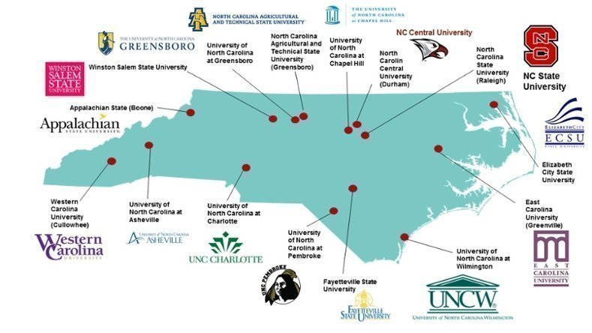
University of NC System
16 Member Institutions
Minimum Admission Requirements (MAR)
4 Units of English (English I, II, III, & IV)
4 Units of Math (Math I, II, III, & Math Beyond)
2 Units of the same Foreign Language
Min. GPA 2.5
SAT/ACT Score
SAT - 880
ACT - 17
**Most schools are test optional for the
2024-2025 school year

Slide 5
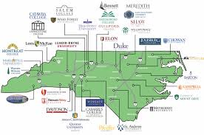
NC Private Schools
36 Private Institutions in NC
Each has own standards for admission
SAT/ACT

Slide 6
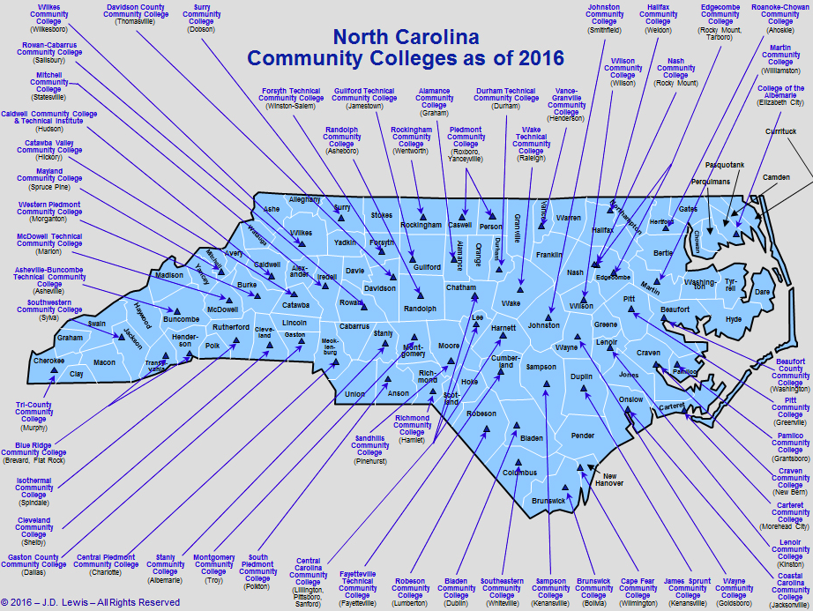
NC Community Colleges
58 schools in community college system
College Transfer/Diploma Program
Open Enrollment

Slide 7
Testing
ACT (www.act.org)
All juniors take at JCHS
SAT (www.collegeboard.org)

Slide 8
College Application Week
NC Countdown to College @ www.cfnc.org
October 16, 2023 - October 20, 2023
Support high school students in completing three important enrollment steps: residency, FAFSA, and applications.
Many private schools will waive application fees, but most UNC system schools do not.
Beware: this date may be after the private school scholarship deadlines.

Slide 9
College Foundation of North Carolina (CFNC)
All students will need to create an account at www.cfnc.org.
Send Transcripts
Apply to College
Admission Deadlines
College Search

Slide 10
CFNC Homepage

Slide 11
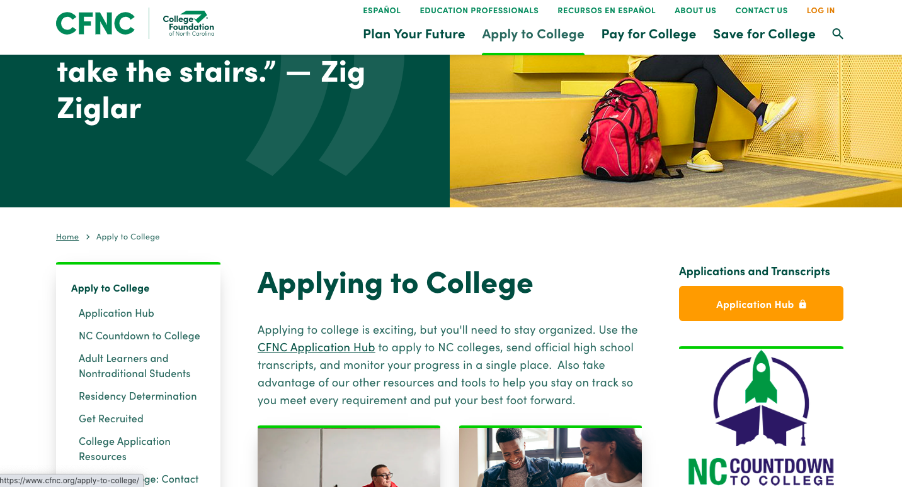
CFNC
Apply to College
Application Hub
Start Application
Request Transcript
This is how students will request transcripts sent to any NC school. Will automatically send final transcript at end of senior year.

Slide 12
Applying for Admission
Meet deadline for colleges in which you are interested
Complete all questions accurately and completely
Give time for people to write letter of recommendation
Spell Check
Save all documents for your records

Slide 13
Extra Curricular
Demonstrated Leadership
Length of participation
Accomplishments

Slide 14
Recommendations & Essays
Speak about you as an individual…what interests and/or excites you?
How are YOU unique?? (What are you doing that other students are not?)
Follow directions
Do not simply list accomplishments (your brag sheet should do that or it will be included in the application).

Slide 15
Admission Decisions
GPA
Rigor
SAT/ACT Scores
Extra Curricular
Recommendations
Essay

Slide 16
Residency Determination Service (RDS)
Centralized residency service for all students seeking in-state tuition
Required for students to be eligible NC state grant as part of their financial aid package.
ncresidency.cfnc.org

Slide 17
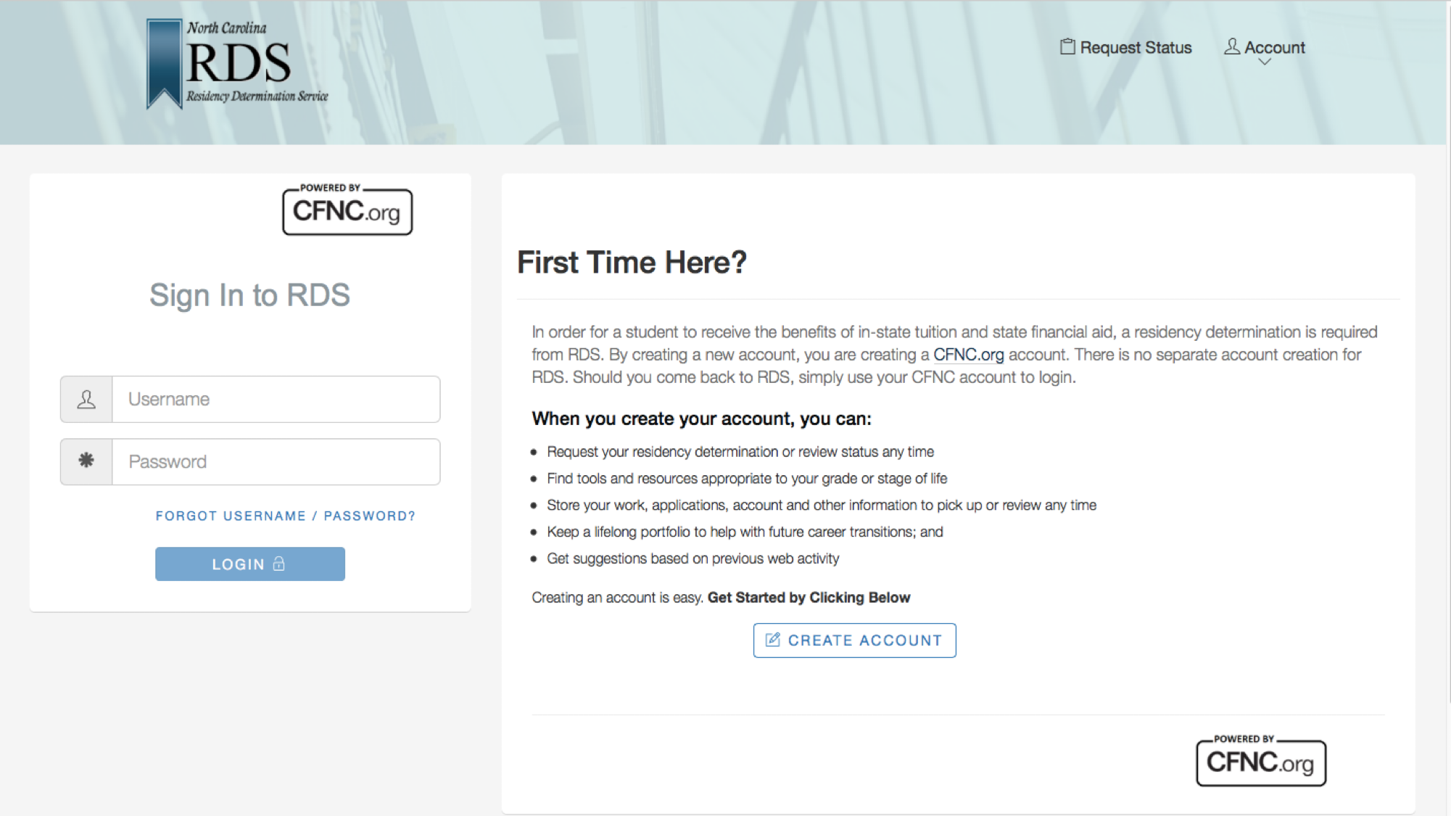
RDS

Slide 18
RDS
Use CFNC account to login
When completed, student receives Residency Certification Number (RCN)
CFNC Applications -RCN autofills
Common App - RCN must be entered manually

Slide 19
Types of Financial Aid
Scholarships
Grants
Self-Help
Loans
Employment/ Work Study

Slide 20
Student Financial Aid
Merit-Based
academics
talent
athletics
others
Need-Based
financial considerations based on FAFSA

Slide 21
Need-Based Aid
Family is responsible for cost to the extent of its ability to pay college costs, even if not willing to pay. (SAI = Student Aid Index)
Provides access and choice
Annual Determination of Eligibility (Must complete FAFSA each year in school)

Slide 22
Applying for Federal Financial Aid
Free Application for Federal Student Aid (FAFSA)
OPENS December (New FAFSA)
Required for all types of federal aid
Complete at www.fafsa.ed.gov.
Results sent electronically to institutions listed by student on FAFSA and to the student (if you provide your email address).
CFNC Financial Aid Presentation - October 4, from 6:00-7:00 - Timeka Ruffin

Slide 23
Applying for State Financial Aid
The FAFSA is the application for most major state programs.
Other state programs may require additional form or the College Service Scholarship Profile (CSS Profile). See www.cfnc.org for details by program. (WF, Elon, Davidson, UNC, Duke)
https://www.finaid.ucsb.edu/fafsasimplification/index.html

Slide 24
Offers May Be…
Legitimate offers of information and assistance
Example: www.cfnc.org
Misleading offers from individuals or companies trying to make money off unsuspecting parents and students

Slide 25
Potential Scams
“The scholarship is guaranteed or your money back.”
No one can guarantee a scholarship before it is awarded.
“Come to our free seminar and we’ll show you how to get more financial aid.”
This is a sales pitch. Don’t pay for information that you can get elsewhere for free.

Slide 26
Where can you find truly FREE information about Financial Aid?
Contact College Foundation of North Carolina at www.cfnc.org or 866-866-CFNC
Service of the State of North Carolina
The Student Guide
Published by the US Department of Education https://studentaid.ed.gov/sa/
Ask your high school counselor
Talk to Financial Aid Administrators at the college of your choice.
Apply for Federal Financial Aid at https://studentaid.gov/h/apply-for-aid/fafsa.

Slide 27
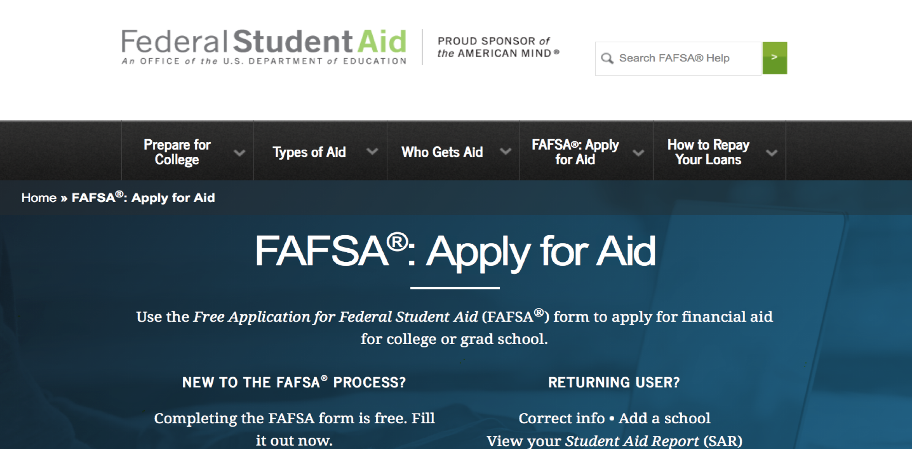
FAFSA Homepage

Slide 28
Senior Year
Narrow list of schools and send applications in the Fall
Complete FAFSA
Apply for Scholarships
Senior Canvas Group, parent email list, individual searches, Twitter.
www.carsonguidance.weebly.com
Stay active in school!

Slide 29
Senior Scholarships
State-wide Organizations
Local Organizations
Churches
Civic Groups
Parents’ Employers
Carsonguidance.weebly.com/scholarships.html

Slide 30
Resources
https://studentaid.gov/h/apply-for-aid/fafsa
www.petersons.com
www.scholarships.com
Websites
www.cfnc.org
www.finaid.com
www.fastweb.com
Counselors
College Admission & Financial Aid Offices

Slide 31
Senior Parent Email Sign-Up

Slide 32
FAFSA Night - January
Once we receive the exact date FAFAS will open we will schedule a “FAFSA Night” at Carson with RCCC!

Slide 33
Questions

