Slide 1
Getting in
“Begin with the end in mind”
-Stephen Covey
8/29/19

Slide 2
What prompted this presentation?
Morehead-Cain Scholarship
“Scholarships are a priority to us” - Parent
School Employees (E, W, N)
Changes in grading scale
Back when I was in high school or
My niece got in so I know my child will
NC State and UNCW admissions
#1 in the class may already be decided

Slide 3
Grade Point Average (GPA)
Honors English I A 4.5
Health PE B 3.0
Honors Biology B 3.5
Art C 2.0
Quality Points 13
13 QP / 4 Classes = 3.25 GPA

Slide 4
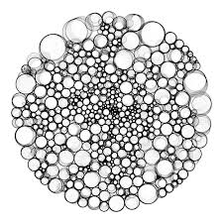
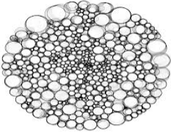

Slide 5
Selective College Admissions
Some you have control over
Transcript
Test Score
Involvement in the school or community
Special talents
Likelihood to enroll
Some you have no control over
Institutional priorities (recruiting area/academic needs/increasing diversity on campus, etc).
How are you going to affect their numbers?

Slide 6
Mid 50 Percent

Slide 7
Hard to have better than the numbers at competitive schools (Transcript Rules).

Slide 8
Real numbers UNCA, UNCC, UNCW
Middle 50% GPA (weighted) - 3.94 - 4.48*
Middle 50% SAT (CR/M) – 1120 – 1290
Middle 50% ACT, - 23 – 28
You are more than the sum of your GPA We want to learn about who you are, what you are passionate about and what you can contribute to the Appalachian *Source ASU Admission Website

Slide 9
NC State numbers
29,800 UG Applications
48% in top 10 %*
Average SAT (1260-1380) 1320*
Average ACT – (27-32) 29 (7)*
In coming class of 2021 if China were a state it would rank #1 in terms of most number of application from out of state (1140). Virginia 1071
*NC State First Year Facts C/) 2022

Slide 10
Real numbers Wake 27%, Duke 5.7%, Davidson 18%
43,000+ Applications 21% Admitted (9500)
We’re recruiting a team of people who will work together, we want a variety of strengths and talents that, together, will form a whole that is greater than the sum of its parts. (UNC Admission Website)

Slide 11
Well rounded (89 Seniors)
Plays a sport – 49
Performed in Arts program – 41
Is employed – 54
Is a Crosby Scholar – 39
Member of NHS – 70
Member of an organization at Carson (O&B, FFA, Student Gov., Prom) – 69
Active in Church program – 42
When on a mission trip - 30

Slide 12
Notes:
4 Classes Hiding, Running, Climbing, Flying
Gator excellent at hiding, so at running but not so good at climbing. So extra work at Climbing
Owl got to top first in climbing but was told to start over.
Focus on strengths

Slide 13
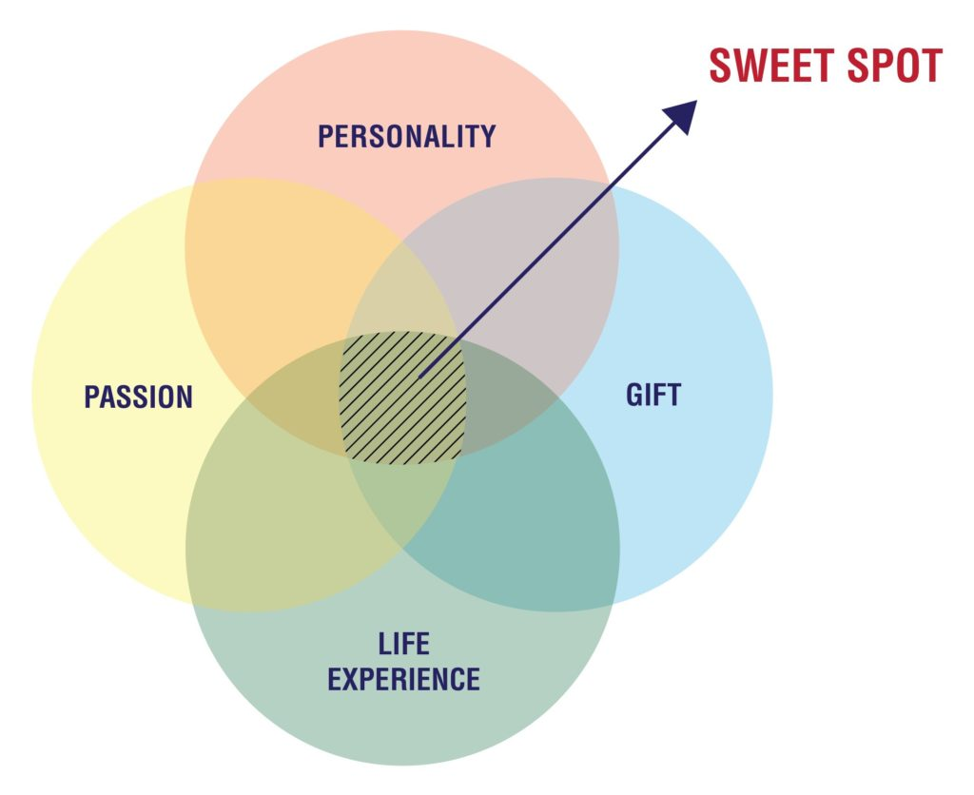
Exceptional individuals
2nd place in national organist competition.
Wrote their own play and had it performed by several schools
Park Scholar Activities focused in an area (horse riding, FFA, 4-H)
If your student is doing something with 10 other Carson Students it’s not exceptional.
An interesting 5 or 10 is more valuable than a boring 1.

Slide 14
What are they really looking for?
First and foremost, colleges must select students who are academically qualified, but from that point, the process is about class-building and adding a variety of individuals who will further the college’s mission and enrich its campus. (Wake Forest Admissions FAQ)

Slide 17
What are they really looking for?
In order of importance, Davidson emphasizes:
Rigor - The difficulty of high school course selections
Success - Grades received
Writing ability and personal impact - An evaluation of essays and recommendations
Involvement, leadership, and service - The depth and breadth of extracurricular pursuits
Testing - Scores on the SAT and/or ACT.

Slide 18
Improve your odds
The “Take good classes make good grades.”
Your child should do a few of things exceptionally and with passion. Start Early.
Quality over quantity
LEADERSHIP and DEMONSTRATE it.
Visit. College Visit / Open House / Summer programs.
Find (Student Led) the best college FIT.
Its going to take work

Slide 19
Contact
Twitter @CarsonGuidance
Carsonguidance.weebly.com
vincent.connolly@rss.k12.nc.us

